Slide 1

Nationally Determined Contributions (NDCs) Overview
Poland

Slide 2

Three NDCs of Poland…
The EU and its Member States are committed to a binding target of an at least 40% domestic reduction in greenhouse gas emissions by 2030 compared to 1990.
Poland wants to reach the goal by:
limiting carbon dioxide emission by reducing the energy from hard coal from 80% to 57% in 2030 and 38% in 2050;
reduction of CO2 emissions by 2030 to a 37.5% for new passenger cars and 31% for vans.
afforestation of areas.

Slide 3
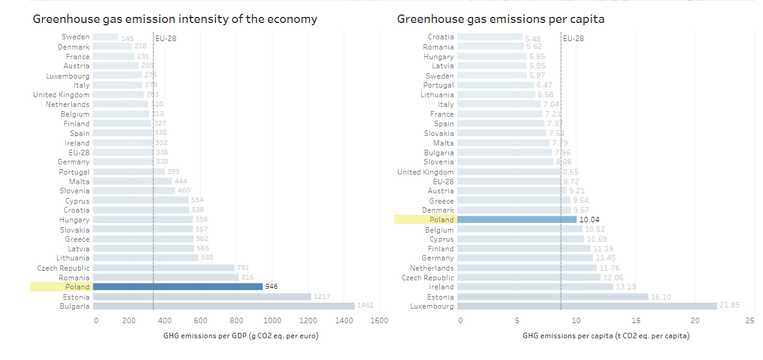
Poland is not among the largest emitters of greenhouse gases globally. Its global share in GHG emissions is just 1%. A critical difference in the make-up of Poland’s emissions is the dominance of the power sector and its extraordinary dependence on coal. Apart from energy sector, Poland’s transport sector has experienced very high rates of emission growth (it’s approximately 24% of total CO₂ emissions). However, Poland’s carbon emission in 2020 dropped by 23% due to the COVID-19 pandemic. Meanwhile, daily global CO2 emissions decreased by 17%.

Slide 4
Progress Towards Meeting NDCs

Slide 5
Reduction of CO2 emission for new cars and vans
  Cars and vans generate 15% of the EU's CO2 emissions. Parliament approved stricter CO2 emission limits for cars: the new CO2 reduction targets for 2030 are a 37.5% reduction for new passenger cars and 31% for vans. Since January 1, 2020, 95 percent of cars sold in the European Union have to enter a consumption limit of 95 g CO2 /km.
  Poland will increase the operating costs of ICE-powered cars (levy on CO2 emissions) and the decrease in the prices of low-emission vehicles (electric and hybrid) will result in a dynamic increase in the number of electric vehicles in Poland – around 350.000 vehicles per year.
The structure of the passenger car fleet in Poland will change: 7% share of electric cars and 5% hybrid cars in 2030 and 54% electric cars and 10% hybrid cars in 2050.

Slide 6
Afforestation of areas
  Polish forests absorb around 42 million tonnes of CO2 per year. The State Forests realizes a pilot program called "Forest Coal Farms". It covers 12 thousand. ha of forests in 23 forest districts. The program goal is to increase the capacity of forests to absorb carbon dioxide, which is responsible for the greenhouse effect.
  Currently, the forest area in Poland counts over 9.2 million hectares. Compared to other European countries, Poland is one of the leaders in the amount of carbon bound in wood biomass in forest areas. Polish forests can store 900 million tons of coal. In 2018, the Polish State Forests planted a total of 729 million seedlings of trees and forest shrubs, of which almost half (47.3%) were trees of deciduous species.

Slide 7
Priorities

Slide 8
Coal consumption
Poland is the 9th largest coal producer and consumer in the world. Coal is a strategic importance to the Polish economy. Compared with other EU member states, Poland has much larger reserves and makes good use of hard coal.
In our opinion priority in our country is to increase energy obtained from renewable sources. At this moment 80% of electricity in Poland is produced from hard coal. Poland's reliance on coal is not going to end soon. The official document on the Polish energy policy up to 2050 makes it clear that coal will not disappear from the national energy mix. Poland plans to reduce coal consumption to about 57% in 2030 and decrease to 38% in 2050.
Poland intends to reduce support for mining regions, which will result in the cessation of the development of coal mines, which will result in a decrease in coal extraction and its consumption.

Slide 9
Role/ Responsibility in Continent

Slide 10
Roles of Poland within the continent
Poland volunteered to organize the Summit at home and was granted this right. Hosting and leading the COP24 in Katowice, it represents the East European group for the third time. The first Summit in Poland took place in Poznan in 2008 and Warsaw in 2013.
Between 2nd and 14th of December 2018 24th session of Conference of Parties to the United Nation Framework Convention on Climate Change was held in Katowice. During those two weeks almost 23 000 participants, including representatives of Parties, non-governmental organizations and media participated in negotiation process to prepare package of decisions with set of rules needed to implement the Paris Agreement.

Slide 11
Youth Action

Slide 12

YOUTH can best help our government meet the NDCs by...
Raising awareness amoung teenangers by e.g. presentations, leaflets or posters showing this climate problem
Doing school projects about these kinds of issues;
Promoting ecological lifestyle (in current situation e.g on on social media);
Planting trees;
Garbage segregation;
Using bikes or public means transport rather than cars;

Slide 13
Thank you
Paulina
Wiktoria
Agata
Amelia
Bogna
Emilia
Jagna
Ewa
Iga
Kajetan
Kasia
Maria
Martyna
Mateusz
Olga
Zuzanna
Sonia

Slide 14
Resources:
https://www.eea.europa.eu/themes/climate/trends-and-projections-in-europe/trends-and-projections-in-europe-2016/country-profiles-greenhouse-gases-and-energy/poland-ghg-and-energy-country-profile.pdf/view
https://climateactiontracker.org/countries/eu/
https://www.politico.eu/article/poland-pis-europe-rules-new-tune/
https://cop.wwf.pl/en/cop24-katowice
https://silo.tips/download/poland-s-greenhouse-ga-s-emissions
https://ourworldindata.org/grapher/consumption-co2-per-capita?tab=chart&time=1990..latest&country=~POL&region=Europe
http://climatecake.pl/aktualnosci/analysis-co2-emissions-reduction-paths-in-the-transport-sector-in-poland-in-the-context-of-the-european-green-deal/?lang=en

