Slide 1
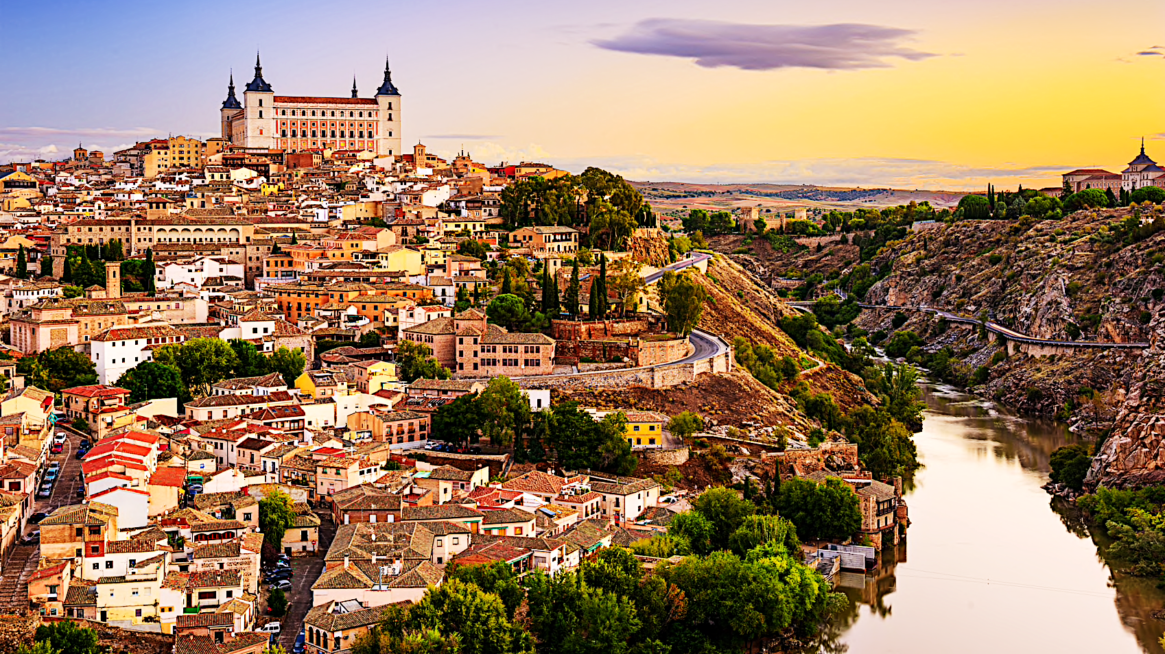
SPAIN

Slide 2

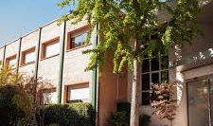
LICEO SOROLLA
Pozuelo de Alarcon, Madrid

Slide 3
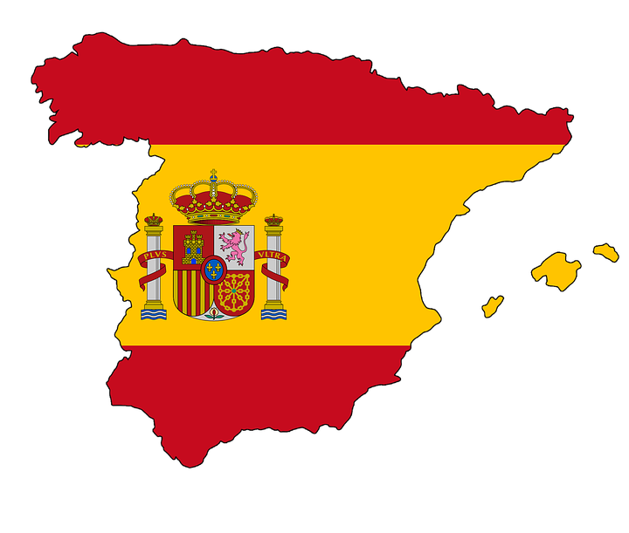
SPAIN

Slide 4
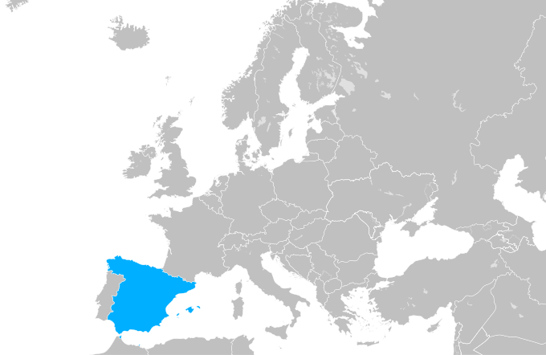
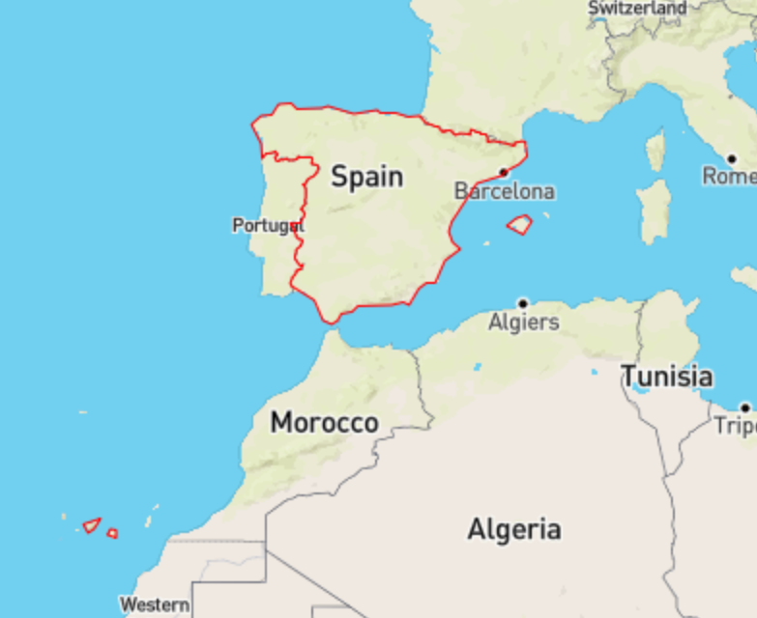
TERRITORY
Capital: Madrid
Iberian Peninsula (Europe)
Second largest country of the EU
Surrounded by:
- Atlantic Ocean
- Mediterranean Sea
Two Archipelagos:
- Canary Islands (coast of Africa)
- Balearic Islands (Mediterranean sea)

Slide 5
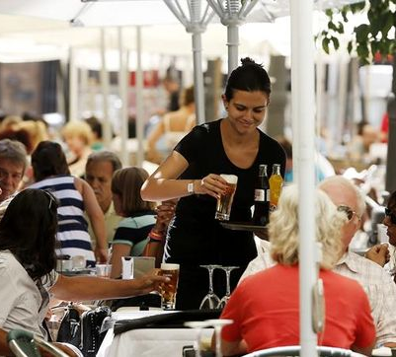
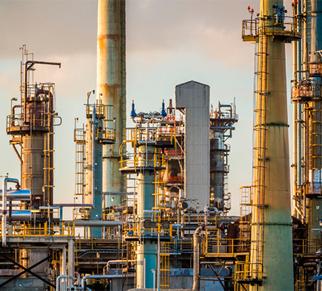
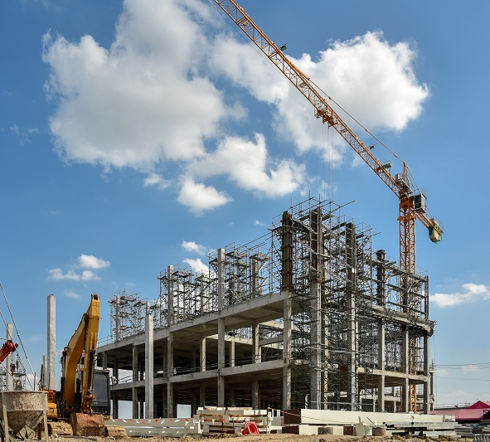
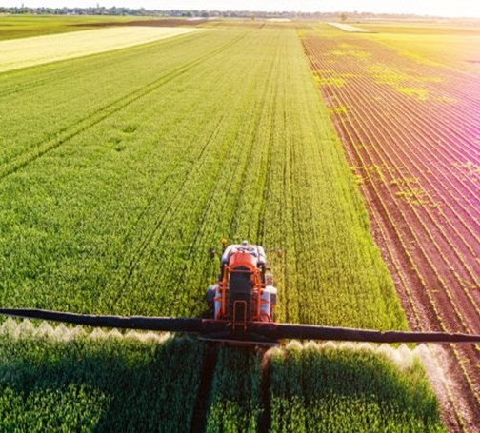
ECONOMY
Mostly service activities
Second largest sectors:
  Industry
  Construction
  Agriculture

Slide 6
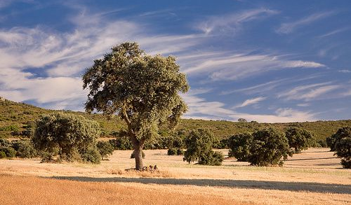
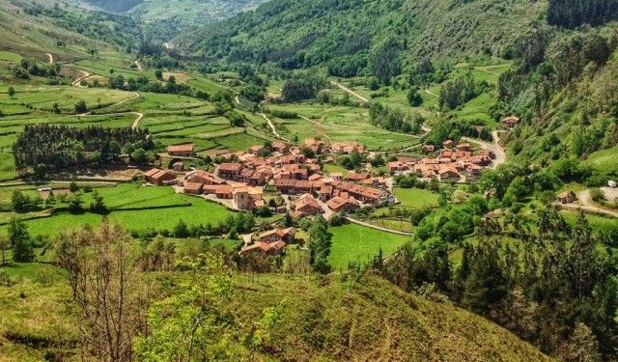
CLIMATE
4 seasons:
  Summer=> very hot
  Winter=> very cold
  Spring=> temperature ranges from warm to cool
  Fall=> same as spring
Temperatures can exceed 45ºC and be lower that -20ºC
Temperature oscillate between 18ºC

Slide 7





FUTURE PROJECTIONS
Worrying situation:
Significant temperature increase
Desertification of the Peninsula=> harmed agriculture and decrease of land
Flooding and meteorological disasters such as storms
Sea level increase

Slide 8

CLIMATE RISK
The poor will be more exposed and vulnerable to impacts because of lower capacity to adapt
Supporting the poor by planning and implementing adaptation actions can enable them to become more ready to adapt to climate change

Slide 9
WHAT SPAIN DETERMINED IN 2015 WITH THE OTHER MEMBERS OF THE EU
TARGET: at least 40% domestic reduction in greenhouse gas emissions by 2030 compared to 1990
FAIR AND AMBITIOUS: 20% emission reduction commitment by 2020 compared to 1990
PERIOD: January 1, 2021- December 31, 2030
BASE YEAR: 1990
SCOPE: All greenhouse gases not controlled by the Montreal Protocol:
  - Carbon Dioxide (CO2) - Perfluorocarbons (PFCs)
  - Methane (CH4) - Sulphur hexafluoride (SF6)
  - Nitrous Oxide (N2O) - Nitrogen trifluoride (NF3)
  - Hydrofluorocarbons (HFCs)

Slide 10


WHAT SPAIN HAS ACHIEVED

Slide 11
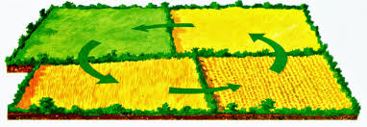
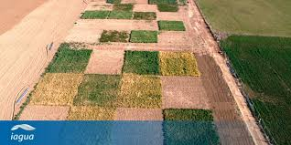
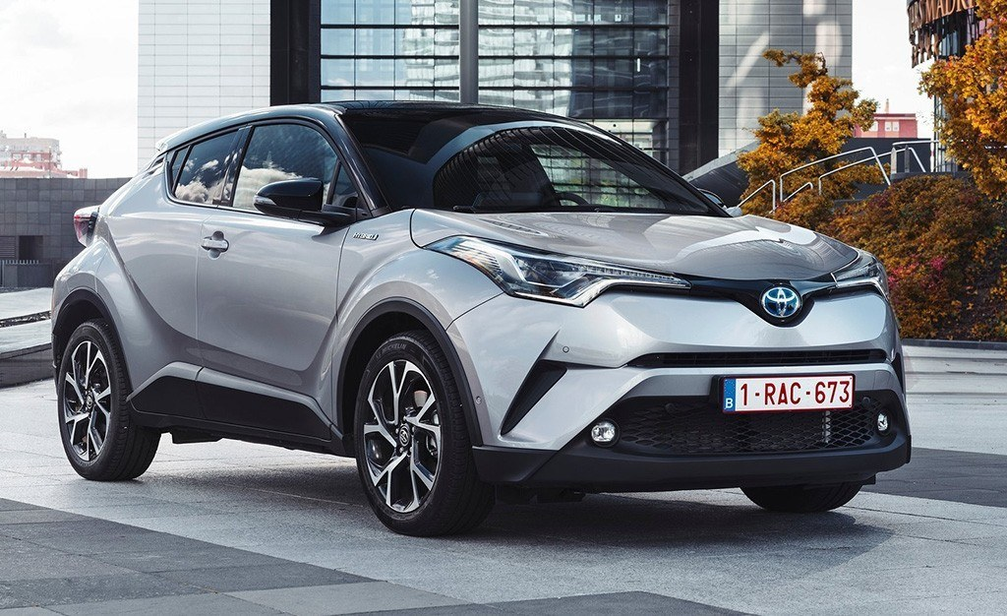
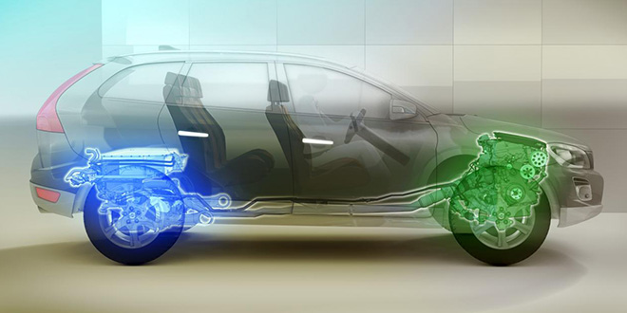
Spain achieved to reduce 20% of greenhouse gas emissions in 2017. Before the established date in 2020
Agricultural policies: Spain is prioritizing crop rotation to facilitate the use of legumes that help fix nitrogen in the soil, preventing it from going into the atmosphere.
Increased sales in hybrid cars: In August 2020, plug-in hybrid vehicle registrations reached 1,336. 199.5% more than in the same period of 2019.

Slide 12
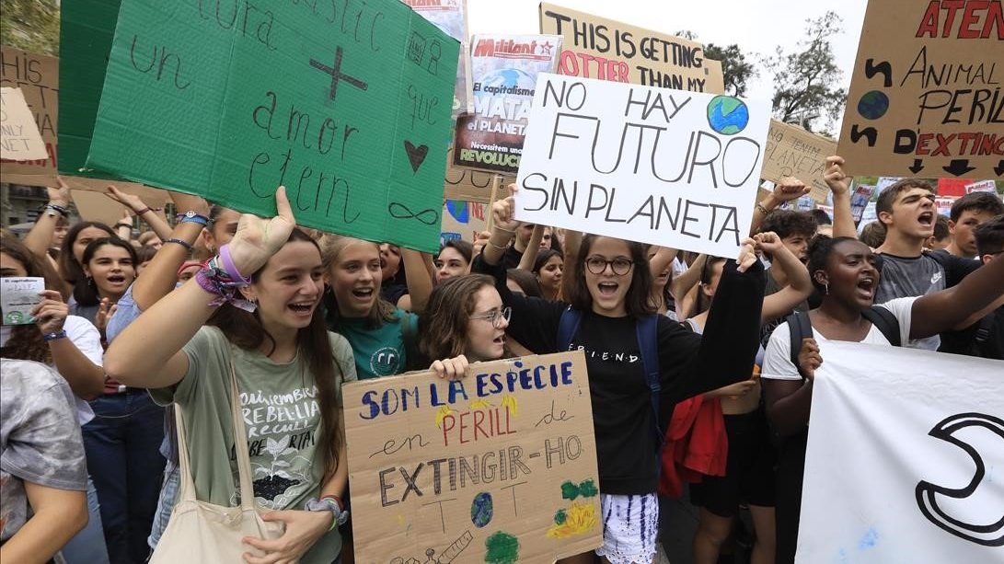
SPREAD AWARENESS: Young people are spreading the message that climate change isa real global problem.
  27th of september 2019=> Mass mobilization
  In 2019 in Madrid and Barcelona 40.000

Slide 13
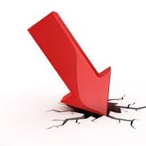
WHAT SPAIN IS DOING POORLY

Slide 14
What Spain is doing poorly
Spain’s efforts are still not enough to meet the EU’s standards, Spain ranks at 21 out of 28 countries of europe on its policies to combat climate change.
INCREASE IN CO2 GAS EMISSIONS:
  - CO2 emissions in 2015: 262.683 kilo tons
  - CO2 emissions in 2018: 276.047 Kilo tons
  - CO2 emissions in 2019: 314,9 kilo tons
Transportation is behind other sector when it comes to decarbonization. It accounts for 26% of all greenhouse emissions. Spain is not doing well in its actions to prevent the 2⁰ safety limit rise.

Slide 15
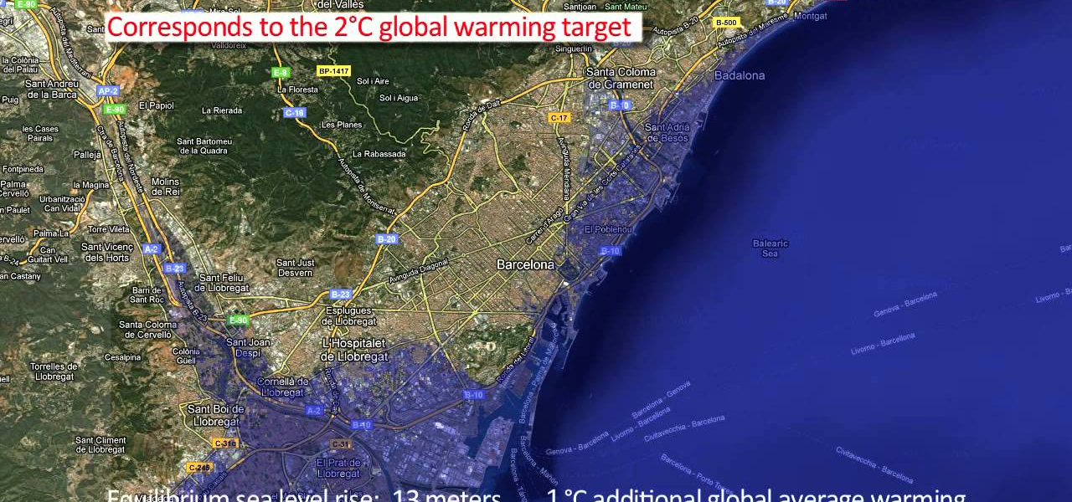
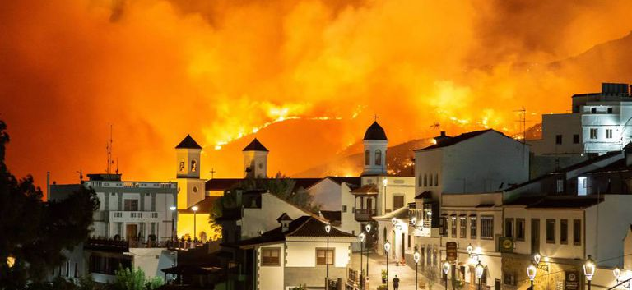
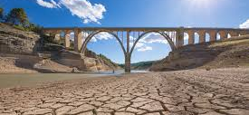
CURRENT SITUATION
Spain is one of the most vulnerable countries in Europe that is affected by climate change
SEA RISE: between 2 and 5 mm per year.
  - A rise of 5 mm / year implies that the current average level is about 13.5 cm higher than in the early 1990s
FIRES: in 2019 Northern Spain faced the largest forest fires in two decades The fires have swept across Spanish province near Barcelona, it took 200Km² of land
  - Each year there are more and more fires
DESERTIFICATION: is mainly due to forest fires, the loss of soil fertility of irrigated land by salinization, and erosion.
  - The Mediterranean region one of the areas most severely affected by land degradation

Slide 16
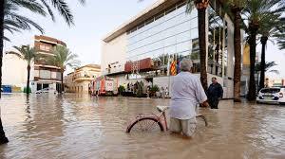
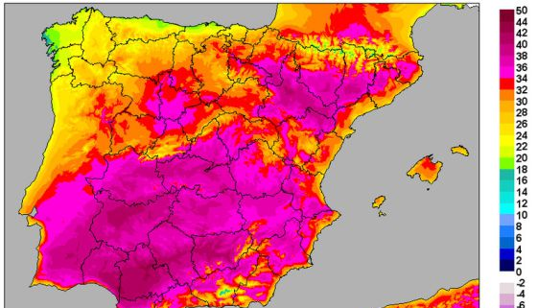
THE COLD DROP: it is an annual meteorological phenomenon that usually coincides with the beginning of autumn and spring in the western Mediterranean.
  Every year they are stronger than the previous year.
INCREASE OF TEMPERATURES: The increase is 0.3ºC per decade, and last year it increased 0.8ºC compared to the average.

Slide 17
THANKS FOR YOUR ATTENTION

